Slide 1
Bring it and Bling it!
Conductive Sewing
Megan Cicconi & Alison Francis
March 26, 2015

Slide 2
1) Open Educreations APP on iPads:
“New lesson”, ignore microphone prompt
In large font, type: Name
School
2) Turn brightness down on iPad
3) Stand near wall mural

Slide 3
Session participants will:
Understand the basics of circuitry
Become familiar with schematic symbols
Build multiple series & parallel circuits
Use littlebits to create more advanced circuitry
Understand components and application of conductive sewing
Create wearable technology

Slide 4
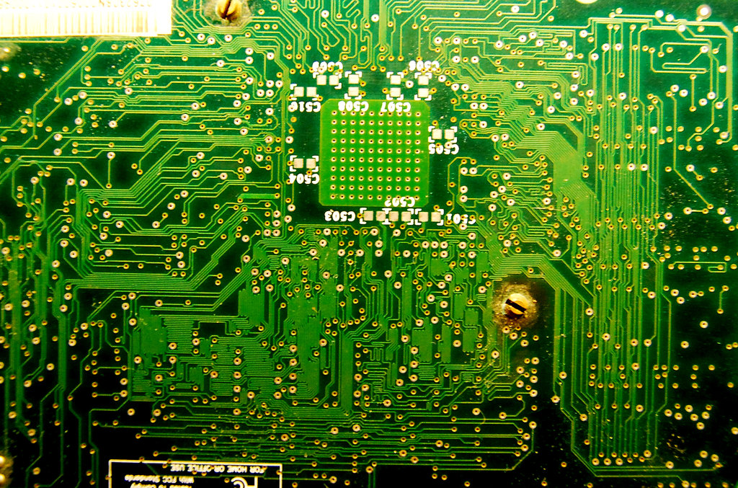
https://www.youtube.com/watch?v=k7aPL5cnYsM

Slide 5
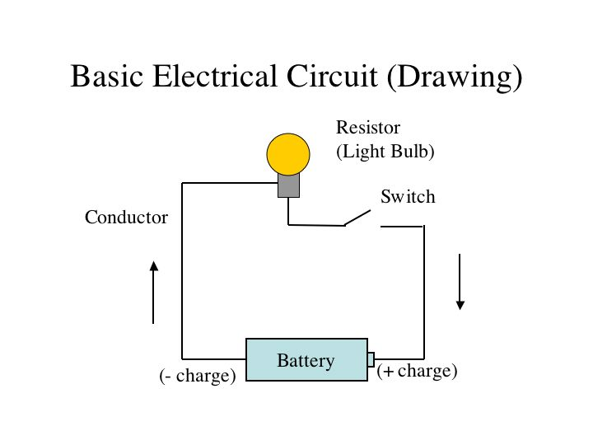

Slide 6
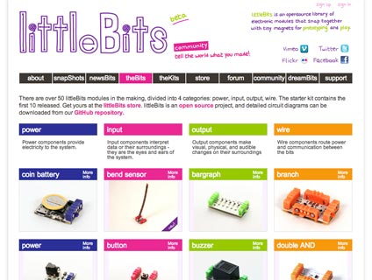

Slide 7
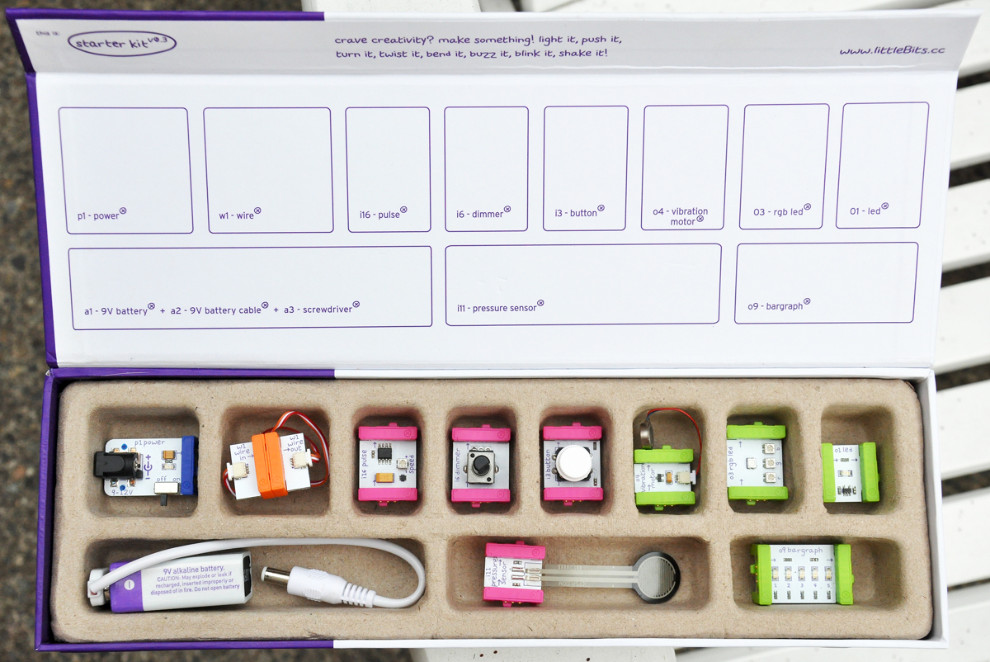

Slide 8
https://www.youtube.com/watch?v=j3g_tdPIo0o

Slide 9
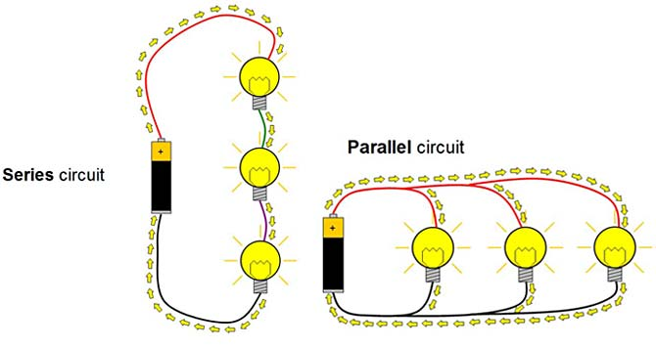

Slide 10
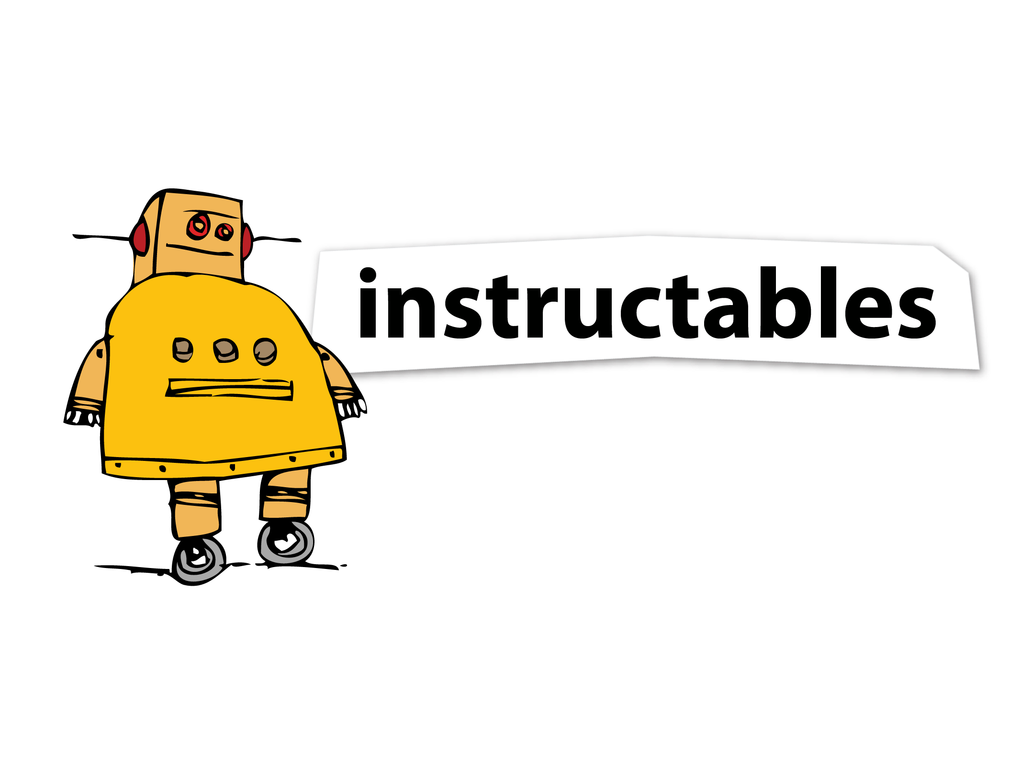
https://www.youtube.com/watch?v=scZpMtyaClM
Notes:
M3D, Staples, Conductive filament, etc

Slide 11
Circuitry Schematics
Add Alison’s pictures of our schematics
Teaching slide
Notes:
M3D, Staples, Conductive filament, etc

Slide 12
Activity Time
Scaffolded

Slide 13
Activity Time
Hard Core

Slide 14
Squishy Circuits

Slide 15
Schematics
Positive
Negative
Connect

Slide 16
Group Sew

Slide 17
Blinging & Beyond

Slide 18
Bling Boutique

Slide 19
Bring it and Bling it!
http://bit.ly/transformEDsessions
Thanks!
Megan & Alison

